Slide 1





Intro to HTML
Data Boot Camp
Lesson 11.1
© 2019 Trilogy Education Services, Inc.

Slide 2
2
~
·+

Slide 3

●
●
●
●
●
●
HTML
CSS
Bootstrap CSS
JavaScript
JavaScript Charting Libraries
And more!

Slide 4

C^{By}la^{th}s^{e}s^{e}O^{nd}bºj^{f}e^{t}cºt^{d}iªv^{y}e^{’s}s^{class you will be able to:}
Fully grasp the mechanics of HTML, CSS and JavaScript as their role building websites.
Comprehensive understanding of the basic parts of an HTML web page and how to create
one from scratch.
Learn to cover and utilize some of the most common HTML tags and selectors.
4

Slide 5

</>
Instructor Demonstration
The Web
5

Slide 6




The Web
What’s the Web?
_{OMYVIDEOS} t09 ... ¡t~ ..
O. FUNNY CATS VI DEO COMPILATION
19,S74,34SVl&N!
ll!r"J _{RizloVlogs k>lowil"IQ}
l_ J Followl· 1.470.068
May,14th2017 lhtSESTKITTENCOMPllATIONEVER
AN'l.~lilhowyw
"'--"'M',11.etrwJ~
":t

Slide 7

Data analysts can use the web to
tell stories with data
and reach millions of people.

Slide 8



The core Three Front-End Web Technologies
The
Web
8

Slide 9
</>
Instructor Demonstration
Hello HTML
9

Slide 10
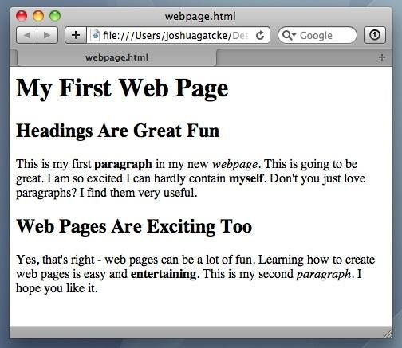
<title>Intro to HTML</title>
Hello
HTML
HTML5
● HTML is one of the three base languages
behind every website.
● It deﬁnes all the basic content and a bit of
formatting.
10

Slide 11
Periodic Table of HTML5 Elements
html
col table
colgroup tr
caption td
head
title
meta
base
link
style
span
a rt rp
fieldset form
meter select
legend optgroup
label option
input output
textarea button
body h1 section
aside h2 header
address h3 nav
datalist h4 article
dfn em i small ins
abbr time b strong del
q var sub mark kdb
cite samp sup ruby bdo
hr p div blockquote
br figcaption ol di
menu
command
summary
details
th
tbody
thead
tfoot
noscript
script
wbr
code
figure ul dt
pre li dd
keygen
progress
h5 footer
h6 hgroup
device video audio track canvas iframe source param object embed map area img
11

Slide 12
Periodic Table of HTML5 Elements
html
h5 footer
h6 hgroup
device video audio track canvas iframe source param object embed map area img
11

Slide 13
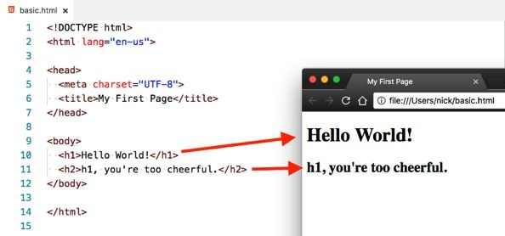
He^{H}l^{T}l^{M}o ^{L}H^{e}T^{le}MmeLnts are rendered by the browser as visible parts of a webpage
12

Slide 14
Hello
HTML
HTML Syntax (Basic)
Content
<h1>
Welcome
</h1>
Opening Tag
Closing Tag
© 2016 | Coding Boot Camp - All Rights Reserved
13

Slide 15
Hello
HTML
HTML Syntax (with Attribute)
Attribute
Content
<a href="www.google.com">
Link
</a>
Opening Tag
Closing Tag
© 2016 | Coding Boot Camp - All Rights Reserved
14

Slide 16
Hello
HTML
Attribute
Tricky Tags (Self-Closing)
<img
src="img.png"
>
Opening Tag
Self-Closing Tag
© 2016 | Coding Boot Camp - All Rights Reserved
15

Slide 17
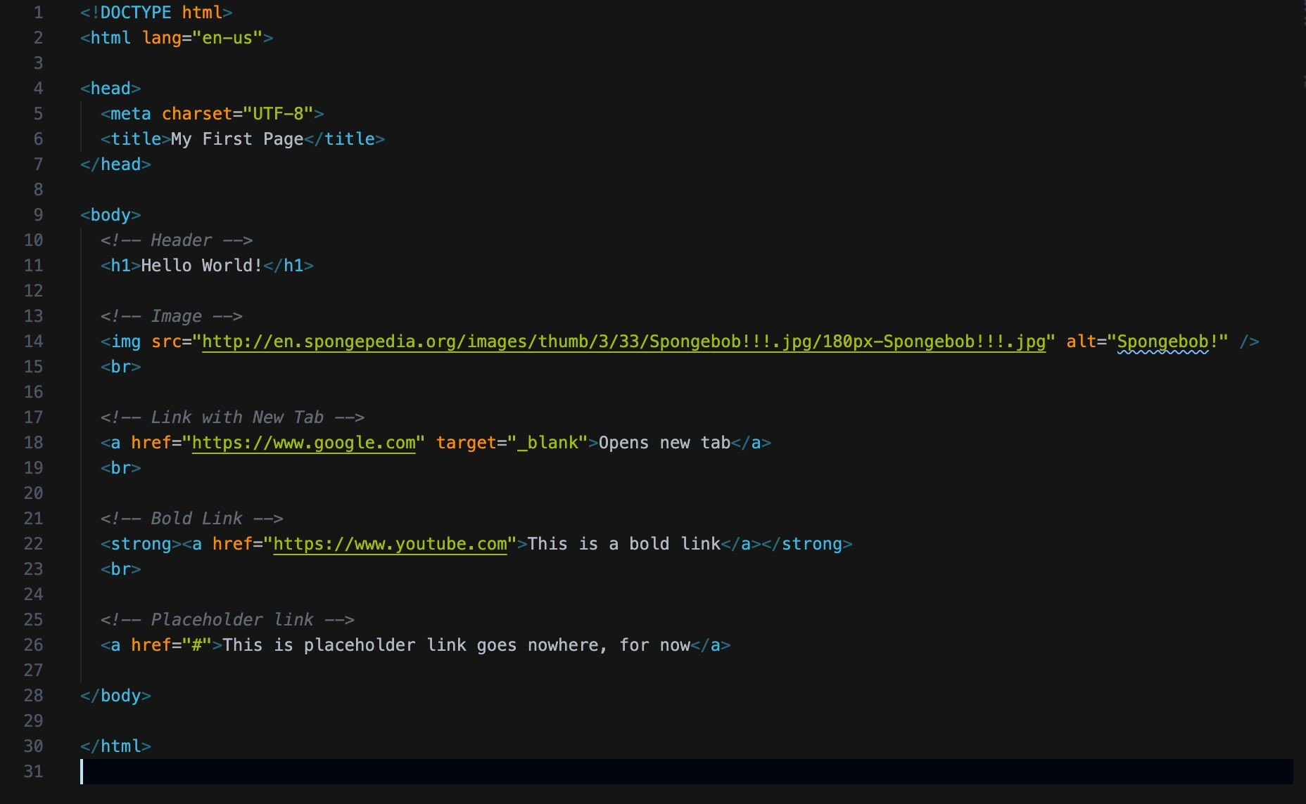
Hello
HTML
16

Slide 18



Activity: Inspect Hello, HTML
In this activity, you and your partner will spend a few minutes going over the example coded out in the last example and use Chrome Devtools to inspect it.
Suggested Time:
5 Minutes
17

Slide 19
Instructions:
Activity:
Inspect
Hello,
HTML
● Open the example from the last activity slacked out to you in Chrome and open Chrome Devtools.
You can launch Chrome Devtools by doing any of the following:
○ Right click the rendered HTML document inside of Chrome and clicking the inspect option.
○ Pressing F12 on Windows while in Chrome.
○ Pressing command + option + i on a Mac.
●
Make sure the
Elements
tab is selected.
●
Study the code here and see how it compares to the actual HTML document slacked out.
●
Experiment with modifying the HTML document in VS Code and reloading the web page and
inspector.
○
What happens when you remove an element's closing tag or misspell
head
or
html
?
18

Slide 20


Time’s Up! Let’s Review.
19

Slide 21
Activity: Research HTML Tags
In this activity, you and your partner will create a list of HTML elements and their descriptions. You should create a valid, informational HTML document in which they use and describe as many of their researched elements as possible.
Suggested Time:
10 Minutes
20

Slide 22
Instructions:
Activity:
Inspect
Hello,
HTML
● With a partner, research and create a list of different HTML elements and their descriptions.
● This list should be a combination of elements we've gone over already and some new elements we
haven't yet discussed.
● Try to list as many elements as possible.
○ Identify which elements are void elements (self-closing), and which are not.
○ Create a valid, informational HTML document where you use and describe and use as many of the different researched elements as possible.
21

Slide 23
Everyone: Discuss HTML Tags
In this activity, everyone will discuss some of different HTML elements we were able to research in the last activity.
Suggested Time:
10 Minutes
22

Slide 24

Different
HTML elements
we were exposed
to so far!

Slide 25
Activity: My First HTML
In this activity, you will create a simple HTML page.
Suggested Time:
15 Minutes
24

Slide 26

Instructions:
Activity: Discuss
HTML
Tags
●
In a new HTML ﬁle, create the basic structure of an HTML document and include in it the following:
○
DOCTYPE
declaration
○
head
tag with nested title tag
○
h1
tag with a title of your choice
○
Embed an image
○
Create the following three links on your page:
■
One link that leads to the website of your choice. Give this link an attribute
target="_blank"
so
■
that it opens a new tab when clicked.
Create a second link to a different website, but give this link bold text.
■ Make the third link a placeholder so it goes nowhere.
●
HINT
: You should be checking the rendered HTML in Chrome as you code to make sure you're going in the
right direction.
● Bonus:
○
Create an ordered list of steps to make a sandwich.
○
Create an unordered list of 5 bands/musicians you like.
○
○
Use an alternate way of separating links without line breaks.
Embed a YouTube video of your favorite band/musician.
25

Slide 27
Time’s Up! Let’s Review.
26

Slide 28

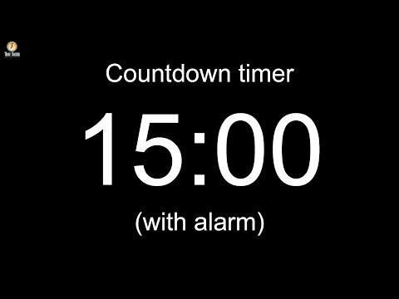

Slide 29
Activity: Fix the HTML
In this activity, you will be tasked with ﬁxing mistakes in a HTML document.
Suggested Time:
5 Minutes
28

Slide 30
Instructions:
Activity: Fix
the
HTML
● Open the index.html ﬁle inside the Unsolved folder.
● This HTML document has several errors. While it may seemingly load browser without
many issues, this is not valid HTML.
● Correct the document and leave a comment above each error describing what you
changed.
○ Refer to the Mozilla HTML Documentation to research any unfamiliar HTML tags.
29

Slide 31
Time’s Up! Let’s Review.
30

Slide 32
</>
Instructor Demonstration
Working with tables
31

Slide 33
The Function of each element that goes into making a table
Working
with
tables
●
●
●
●
●
table
: Acts as a container for our rows and columns.
tr (Table Row)
: These elements serve as rows for our table. They contain a row of table
cells.
th (Table Header)
: These are table cells that are for containing column titles. These will
have bold text by default.
td (Table Data)
: These are table cells for holding data. These are not column titles.
Optional table tags that can be used to give semantic meaning to our table. These include:
○
○
thead (Table Head)
: Acts as a container for the row(s) holding our table headers.
tbody (Table Body)
: Acts as a container for the rows holding our table data that is
not part of the table head.
○
tfoot (Table Footer)
: Acts as a container for bottom rows in a table which acts as a
summary of the tables content. The tfoot element is rendered at the bottom of the
table by default, regardless of which row(s) it's holding.
32

Slide 34
Activity: Working with tables
In this activity, you will create an HTML5 table modeled from a spreadsheet. You will use a border and colspan properties, as well as make use of the thead, tbody and tfoot elements.
Suggested Time:
15 Minutes
33

Slide 35
Instructions:
Working
with
Tables
● Open the Resources folder. Here we have a relatively simple spreadsheet.
● Create a new HTML document and create a table to represent the data in the spreadsheet.
● Try to get the formatting as close to the spreadsheet as possible.
● Bonus: Use table colspan and border attributes to make the table look even more similar to
the spreadsheet.
○ Group the completed table using a thead, a tbody, and a tfoot element.
■ Check you SLACK for a good example of these semantic table elements being
used.
34

Slide 36
Time’s Up! Let’s Review.
35

Slide 37
Activity: More with Images and Links
In this activity, you will create a webpage using images downloaded from their Jupyter notes from previous project.
Suggested Time:
15 Minutes
36

Slide 38
Instructions:
Activity: Fix the HTML
●
Create a new project folder. Inside, create a new HTML ﬁle and name it
index.html
. Fill this
document in with a basic HTML skeleton.
●
Launch Jupyter Notebook, and open any previous project created using
matplotlib
. Download all
images of graphs created with pyplot to your local project folder.
●
At the top of the HTML page, add a H1 tag containing the name of your chosen project.
●
For each downloaded image, add one image element to your
index.html
ﬁle. Set the
src
attribute
of each image to the path to a different image in your project folder. Be sure to add a description
for each image in the
alt
attribute.
●
Add a horizontal rule between each image.
●
Underneath each image, add a description of its graph in italicized text using the
<em>
t.
elemen
●
Add functionality so that when an image is clicked, it will open a new tab to that image's URL
Add functionality so that when an image is clicked, it will open a new tab to that image's URL.
● Bonus:
○
Take advantage of the
figure
and
figcaption
elements to have more semantic markup.
37

Slide 39
Time’s Up! Let’s Review.
38

Slide 40

Not Done yet!!!
Almost there!
TAs please introduce the HW
39

Slide 41


40

